Slide 1
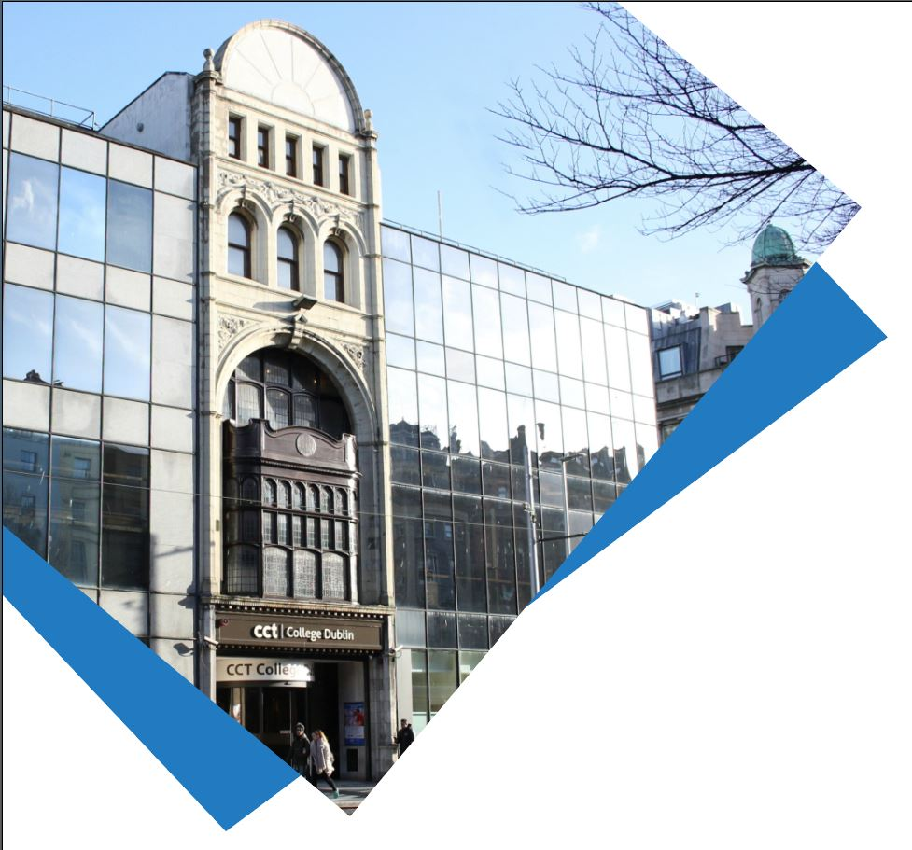

NLP and Topic Modelling Week 8
Machine Learning for Data Analysis MSc in Data Analytics CCT College Dublin
Lecturer: Dr. Muhammad Iqbal*
Email: miqbal@cct.ie
©CCT College Dublin 2022

Slide 2
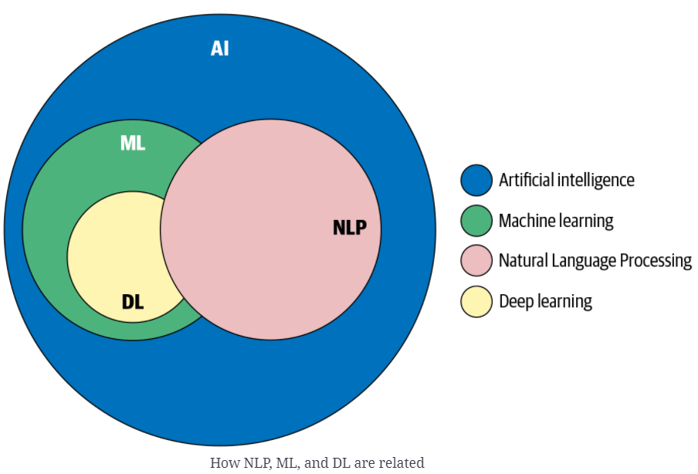
Agenda
Introduction to Natural Language Processing (NLP)
NLP Pipeline
Topic modelling
Latent Dirichlet Allocation
Latent Dirichlet Allocation: Example
Decomposing Text Documents with LDA
Sentiment Analysis
Implementation of Sentiment Analysis
Notes:
Manifold learning is an approach to non-linear dimensionality reduction. Algorithms for this task are based on the idea that the dimensionality of many data sets is only artificially high.

Slide 3
Introduction to NLP
Let's imagine a hypothetical person called John Doe is the CEO of a fast-growing technology company. John wakes up every morning, has this conversation with his personal assistant.
John: “How is the weather today?”
Digital assistant: “It is 37 degrees centigrade outside with no rain today.”
John: “What does my schedule look like?”
Digital assistant: “You have a strategy meeting at 4 p.m. and an all-hands at 5:30 p.m. Based on today’s traffic situation, it is recommended you leave for the office by 8:15 a.m.”
John inquires of the assistant about his fashion choices as he gets dressed:
John: “What should I wear today?”
Digital assistant: “White seems like a good choice.”
You may have used Apple Siri, Google Home, or Amazon Alexa to accomplish similar tasks.
The assistants that we have interacted with do not speak a programming language; instead, they speak English, the language in which we all communicate.
Notes:
CTO: Chief Technology Officer

Slide 4
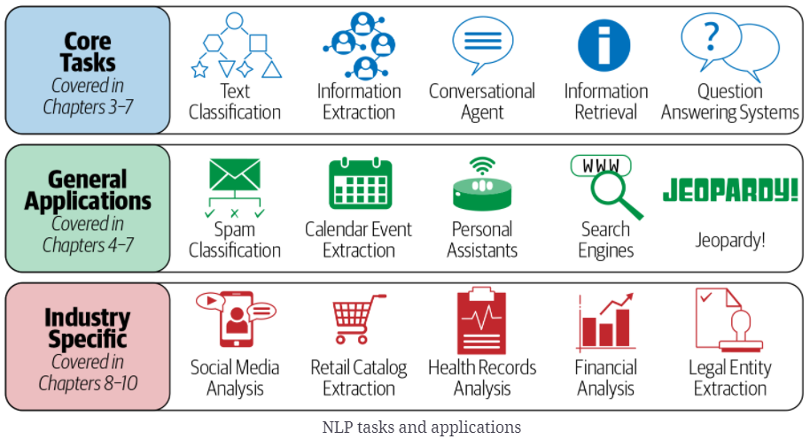
Introduction to NLP
Smart assistants such as Amazon Alexa, Google Home, or Apple Siri to do similar things are commonly used in this world. We talk to these assistants in our natural language rather than programming language.
This natural language has been the primary medium of communication between humans since time immemorial.
Computers can process data in a binary format, such as 0s and 1s. While we can represent language data in binary.
How do we make machines to understand the language?
This is where Natural Language Processing (NLP) comes in. It is an area of computer science that deals with methods to analyze, model, and understand human language.
Every intelligent application involving human language has some NLP behind it.
A given NLP problem may be solved using dozens of alternative approaches because of the open-ended nature of NLP.

Slide 5
Introduction to NLP
In today's area of internet and online services, data is generating at incredible speed and amount.
Data analysts, Engineers, and Scientists deal with relational data or tabular data columns, which may contain numerical or categorical data.
The data has a variety of structures such as text, image, audio, and video. Online activities such as articles, website text, blog posts, social media posts are generating unstructured textual data.
Corporate and Business need to analyze textual data to understand customer activities, opinion, and feedback to successfully derive their business. To compete with big textual data, text analytics is evolving at a faster rate than ever before.
Text Analytics has lots of applications in today's online world. By analyzing tweets on Twitter, we can find trending news and peoples reaction on a particular event. Amazon can understand user feedback or review on the specific product.
Notes:
BookMyShow can discover people's opinion about the movie. Youtube can also analyze and understand peoples viewpoints on a video.

Slide 6
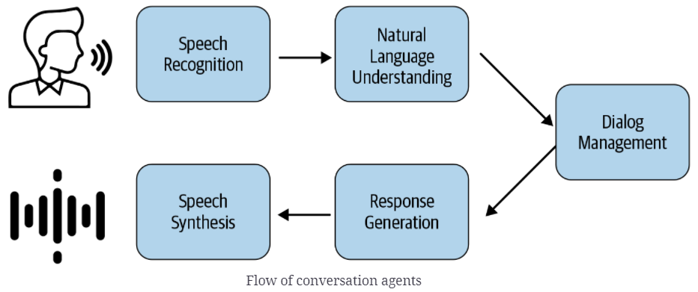
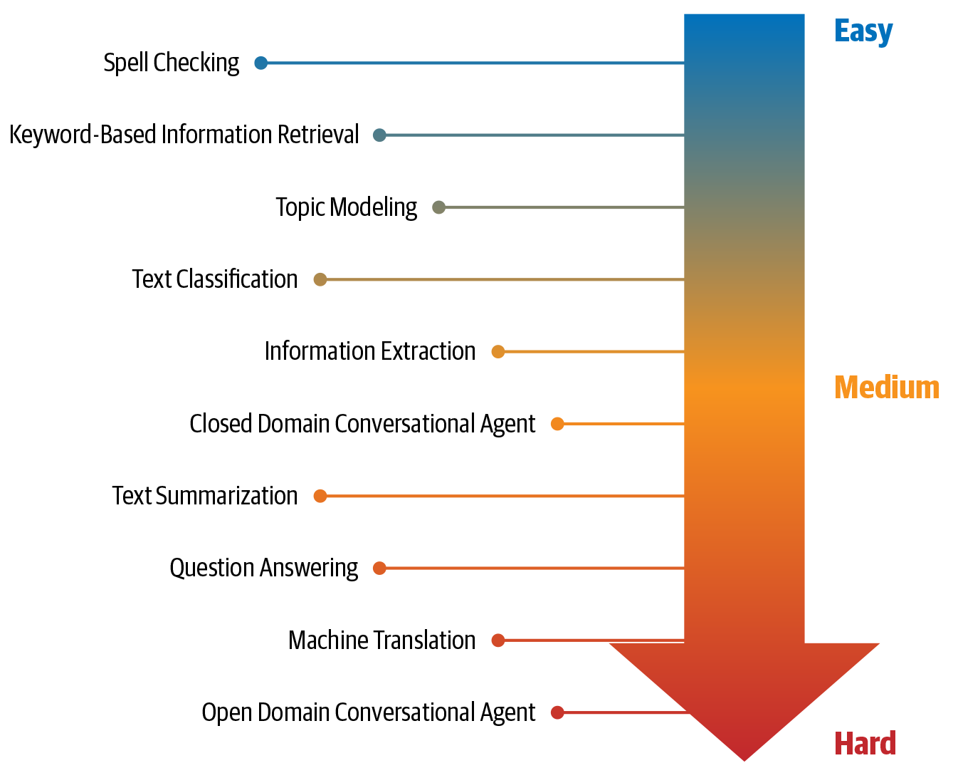
NLP Tasks
There is a collection of fundamental tasks that appear frequently across various NLP projects.
Topic modelling
Text Classification
Information Extraction
Information Retrieval
Conversational agent
Text summarization
Question answering
Machine translation
Figure shows a depiction of these tasks based on their relative difficulty in terms of developing comprehensive solutions.
Notes:
Language modelling: This is the task of predicting what the next word in a sentence will be based on the history of previous words. The goal of this task is to learn the probability of a sequence of words appearing in a given language. Language modeling is useful for building solutions for a wide variety of problems, such as speech recognition, optical character recognition, handwriting recognition, machine translation, and spelling correction.
Text classification: This is the task of bucketing the text into a known set of categories based on its content. Text classification is by far the most popular task in NLP and is used in a variety of tools, from email spam identification to sentiment analysis.
Information extraction: As the name indicates, this is the task of extracting relevant information from text, such as calendar events from emails or the names of people mentioned in a social media post.
Information retrieval: This is the task of finding documents relevant to a user query from a large collection. Applications like Google Search are well-known use cases of information retrieval.
Conversational agent: This is the task of building dialogue systems that can converse in human languages. Alexa, Siri, etc., are some common applications of this task.
Text summarization: This task aims to create short summaries of longer documents while retaining the core content and preserving the overall meaning of the text.
Question answering: This is the task of building a system that can automatically answer questions posed in natural language.
Machine translation: This is the task of converting a piece of text from one language to another. Tools like Google Translate are common applications of this task.
Topic modelling: This is the task of uncovering the topical structure of a large collection of documents. Topic modeling is a common text-mining tool and is used in a wide range of domains, from literature to bioinformatics.

Slide 7
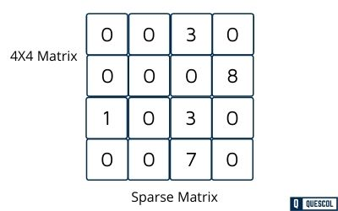
Learning from Text
Most machine learning applications in the text domain work with the bag-of-words representation in which the words are treated as dimensions with values corresponding to word frequencies.
A data set corresponds to a collection of documents, which is also referred to as a corpus. The complete and distinct set of words used to define the corpus is referred to as the lexicon.
Dimensions are also referred to as Terms or Features. Some applications of text work with a binary representation in which the presence of a term in a document corresponds to a value of 1 and 0.
Other applications use a normalized function of the word frequencies as the values of the dimensions. In each of these cases, the dimensionality of data is very large, and may be of the order of 10⁵ or even 10⁶.
Furthermore, most values of the dimensions are 0s, and only a few dimensions take on positive values. In other words, text is a high-dimensional, sparse, and non-negative representation.
Notes:
A sparse matrix is a matrix that is comprised of mostly zero values. Sparse matrices are distinct from matrices with mostly non-zero values, which are referred to as dense matrices.

Slide 8
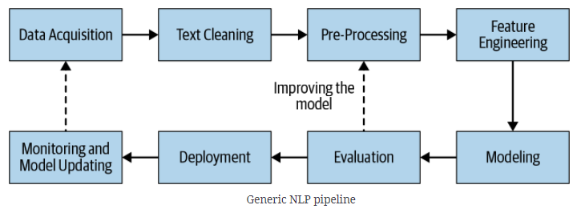
NLP Pipeline
The first step in the process of developing any NLP system is to collect data relevant to the given task. We convert the text into canonical form after cleaning and pre-processing.
Feature Engineering is the process of using domain knowledge to extract features (characteristics, properties and attributes) from raw data.
In modeling and evaluation phases, we build one or more models and compare and contrast them using a relevant evaluation metric(s).
Once the best model among the ones evaluated is chosen, we move toward deploying this model in production.
In the real world, the process may not always be linear as it’s shown in the pipeline in Figure.
It involves going back and forth between individual steps (e.g., between feature extraction and modeling, evaluation, and so on). There are loops in between, most commonly going from evaluation to pre-processing, feature engineering, modeling, and back to evaluation.
In addition, there is an overall loop involving monitoring and data collection, but this loop can be seen at the project level.

Slide 9
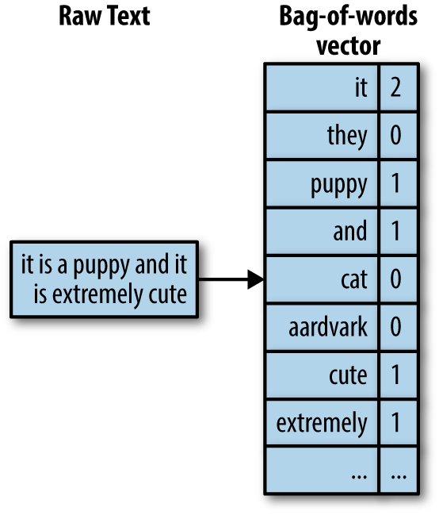
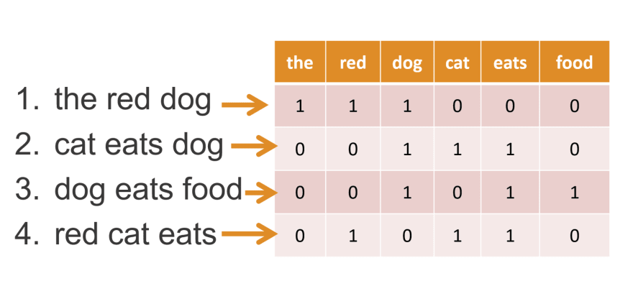
Bag-of-words Model
We have to turn categorical data, such as text or words, into a numeric form before we can pass them on to a machine learning algorithm for the training.
We introduce the bag-of-words, which allows us to represent text as numeric feature vectors. The idea behind the bag-of-words model is quite simple and can be summarized as follows
We create a vocabulary of unique tokens, for example, words: from the entire set of documents.
We construct a feature vector from each document that contains the counts of how each word occurs in the particular document.
Since the unique words in each document represent only a small subset of all the words in the bag-of-words vocabulary, the feature vectors will mostly consist of zeros, which is why we call them sparse.

Slide 10
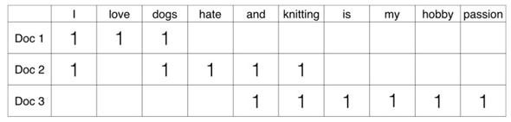
Feature Generation Bag of Words
In the Text Classification, we have a set of texts and their respective labels. But we can't directly use text for our model. We need to convert these text into some numbers or vectors of numbers.
Bag-of-words Model (BoW) is the simplest way of extracting features from the text. BoW converts text into the matrix of occurrence of words within a document. This model concerns about whether the given words occurred or not in the document.
Example: There are three documents
Doc 1: I love dogs. Doc 2: I hate dogs and knitting. Doc 3: Knitting is my hobby and passion.
We can create a matrix of document and words by counting the occurrence of words in the given document. This matrix is known as Document-Term Matrix (DTM).
from sklearn.feature_extraction.text import CountVectorizer

Slide 11

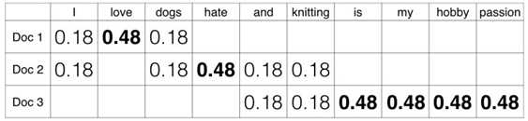
Feature Generation TF-IDF
In Term Frequency (TF), we count the number of words occurred in each document. The main issue with this Term Frequency is that it will give more weight to longer documents. Term frequency is basically the output of the BoW model.
IDF (Inverse Document Frequency) measures the amount of information a given word provides across the document. IDF is the logarithmically scaled inverse ratio of the number of documents that contain the word and the total number of documents.
TF-IDF (Term Frequency-Inverse Document Frequency) normalizes the document term matrix. It is the product of TF and IDF. Word with high tf-idf in a document, it is most of the times occurred in given documents and must be absent in the other documents. So, the words must be a signature word.
Notes:
Log(3/2) = 0.18
Log(3/1) = 0.48

Slide 12
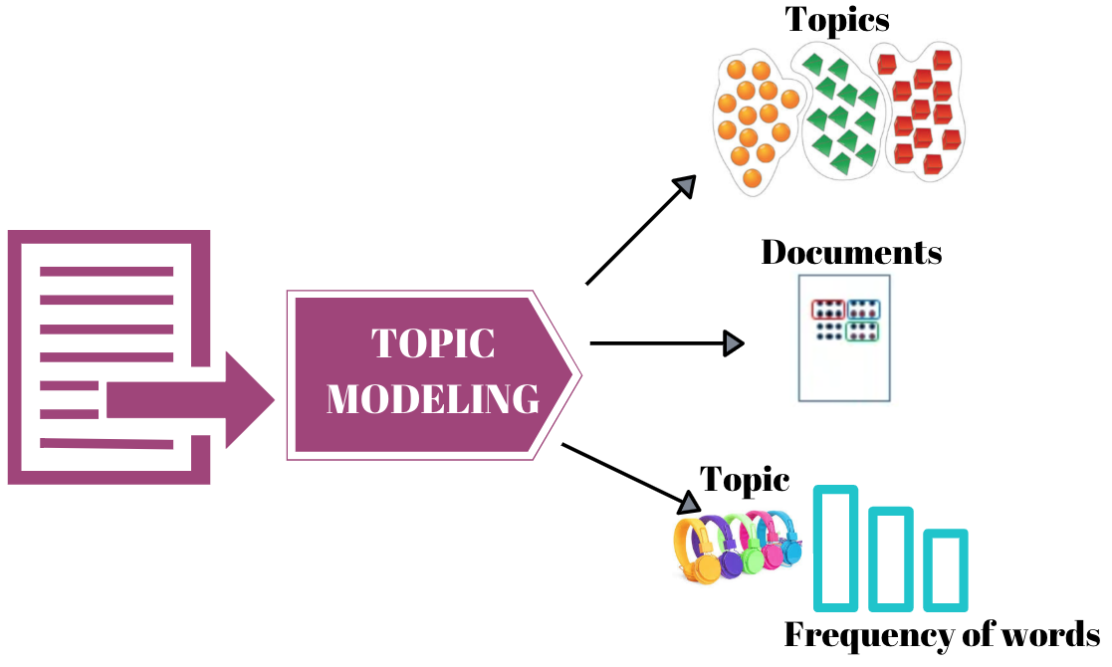
What is Topic Modeling?
Topic modeling is an unsupervised technique that intends to analyze large volumes of text data by assigning topics to the documents and segregate the documents into groups based on the assigned topics.
In the case of topic modeling, the text data do not have any labels attached to it. Rather, topic modeling tries to group the documents into based on similar topics.
A typical example of topic modeling is clustering a large number of newspaper articles that belong to the same category.
In other words, cluster documents that have the same topic. It is important to mention that it is extremely difficult to evaluate the performance of topic modeling since there are no right answers.
It depends upon the user to find similar characteristics between the documents of one cluster and assign it an appropriate label or topic.
Latent Dirichlet Allocation

Slide 13
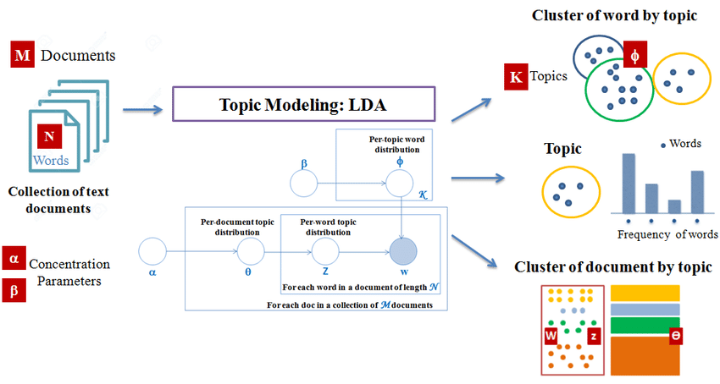
Decomposing Text Documents Latent Dirichlet Allocation (LDA)
LDA is a generative probabilistic model that tries to find groups of words that appear frequently together across different documents.
These frequently appearing words represent our topics, assuming that each document is a mixture of different words.
The input to an LDA is the bag-of-words model. We can take a bag-of-words matrix as input, LDA decomposes it into two new matrices as
A document to topic matrix
A word to topic matrix
LDA decomposes the bag-of-words matrix in such a way that if we multiply those two matrices together, we would be able to reproduce the input, the bag-of-words matrix, with the lowest possible error.
In practice, we are interested in those topics that LDA found in the bag-of-words matrix. For LDA, we must define the number of topics beforehand.
Notes:
Consider a document with four words and two topics.
1) Document: "cat meow dog bark"
Topics: Topic 1 (related to pets), Topic 2 (related to sounds)
We initialize the document-topic matrix (theta) and the word-topic matrix (phi) with some random values at the start.
2) Initialization:
Document-Topic Matrix (theta): [0.5 0.5]]
Word-Topic Matrix (phi):
Column 1 (Topic 1) Column 2 (Topic 2)
0.4 0.6
0.7 0.3
0.5 0.5
0.2 0.8
3) Iteration:
For each word in the document, we reassign the word's topic based on the current theta and phi values.
Word 1: "cat"
Calculate probabilities for each topic based on the current theta and phi.
P (Topic 1) = 0.5 × 0.4 = 0.2
P(Topic 2) = 0.5 × 0.6 = 0.3
Normalize the probabilities to make them sum to 1.
P(Topic 1) = (0.2 + 0.3)/0.2​ = 0.4
P(Topic 2) = (0.2 + 0.3)/0.3​ = 0.6
Randomly choose a topic based on these probabilities. We select Topic 2.
Update the document-topic matrix theta based on the chosen topic.
New θ=[0.5​ 0.5​] + [0 ​1​] = [0.5 ​1.5​]
Update the word-topic matrix phi based on the chosen topic for the word. New ϕ=
Column 1 Column 2 + Column 1 Column 2
0.4 0.6 + 0 1
0.7 0.3 + 0 0
0.5 0.5 + 0 1
0.2 0.8 + 0 1
Column 1 Column 2
0.4 1.6
0.7 0.3
0.5 1.5
0.2 1.8
Word 2: "meow"
Repeat the process for each word in the document.
Repeat:
Continue the iteration process for a fixed number of iterations or until convergence.
Normalization:
Normalize the final theta and phi matrices to obtain probabilities.
This example shows the LDA process, and actual implementations involve more sophisticated calculations and iterations. The goal is to converge to stable values for theta and phi that accurately represent the topics in the documents and the distribution of words in those topics.

Slide 14
Latent Dirichlet Allocation (LDA) Example
We consider the following 5 documents:
Document 1: "cat dog cat"
Document 2: "dog bird"
Document 3: "fish bird fish"
Document 4: "apple banana"
Document 5: "banana apple banana"
Step 1: Preprocessing
Tokenize each document: split the documents into individual words.
Create a vocabulary: collect all unique words in the corpus.
Vocabulary: ["cat", "dog", "bird", "fish", "apple", "banana"]

Slide 15
Latent Dirichlet Allocation (LDA) Example
Step 2: Create a Document-Term Matrix (DTM)
Create a matrix where each row represents a document, and each column represents a word. The entries are the word frequencies in each document.
Document 1: "cat dog cat"
Document 2: "dog bird"
Document 3: "fish bird fish"
Document 4: "apple banana"
Document 5: "banana apple banana"
 | cat | dog | bird | fish | apple | banana
Doc 1 | 2 | 1 | 0 | 0 | 0 | 0
Doc 2 | 0 | 1 | 1 | 0 | 0 | 0
Doc 3 | 0 | 0 | 1 | 2 | 0 | 0
Doc 4 | 0 | 0 | 0 | 0 | 1 | 1
Doc 5 | 0 | 0 | 0 | 0 | 2 | 1

Slide 16
Latent Dirichlet Allocation (LDA) Example
Step 3: Apply LDA
Suppose we consider two topics (K = 2) and running the LDA algorithm on the DTM, we get two matrices as mentioned
Document-Topic Matrix (A document to topic matrix): This matrix represents the probability of each document belonging to each topic as shown in left Table.
 | Topic 1 | Topic 2
Doc 1 | 0.2 | 0.8
Doc 2 | 0.9 | 0.1
Doc 3 | 0.3 | 0.7
Doc 4 | 0.8 | 0.2
Doc 5 | 0.1 | 0.9
 | Topic 1 | Topic 2
cat | 0.8 | 0.2
Dog | 0.2 | 0.8
Bird | 0.7 | 0.3
Fish | 0.1 | 0.9
apple | 0.9 | 0.1
banana | 0.4 | 0.6
The LDA method calculates these probabilities by looking at the co-occurrence patterns of terms in topics and documents as shown in Table on right.
They show the probability that a word associated with a particular topic will appear in a document. These matrices have values between 0 and 1, which add up to 1 for every word or page.
Notes:
Consider a document with four words and two topics.
1) Document: "cat meow dog bark"
Topics: Topic 1 (related to pets), Topic 2 (related to sounds)
We initialize the document-topic matrix (theta) and the word-topic matrix (phi) with some random values at the start.
2) Initialization:
Document-Topic Matrix (theta): [0.5 0.5]]
Word-Topic Matrix (phi):
Column 1 (Topic 1) Column 2 (Topic 2)
0.4 0.6
0.7 0.3
0.5 0.5
0.2 0.8
3) Iteration:
For each word in the document, we reassign the word's topic based on the current theta and phi values.
Word 1: "cat"
Calculate probabilities for each topic based on the current theta and phi.
P (Topic 1) = 0.5 × 0.4 = 0.2
P(Topic 2) = 0.5 × 0.6 = 0.3
Normalize the probabilities to make them sum to 1.
P(Topic 1) = (0.2 + 0.3)/0.2​ = 0.4
P(Topic 2) = (0.2 + 0.3)/0.3​ = 0.6
Randomly choose a topic based on these probabilities. We select Topic 2.
Update the document-topic matrix theta based on the chosen topic.
New θ=[0.5​ 0.5​] + [0 ​1​] = [0.5 ​1.5​]
Update the word-topic matrix phi based on the chosen topic for the word. New ϕ=
Column 1 Column 2 + Column 1 Column 2
0.4 0.6 + 0 1
0.7 0.3 + 0 0
0.5 0.5 + 0 1
0.2 0.8 + 0 1
Column 1 Column 2
0.4 1.6
0.7 0.3
0.5 1.5
0.2 1.8
Word 2: "meow"
Repeat the process for each word in the document.
Repeat:
Continue the iteration process for a fixed number of iterations or until convergence.
Normalization:
Normalize the final theta and phi matrices to obtain probabilities.
This example shows the LDA process, and actual implementations involve more sophisticated calculations and iterations. The goal is to converge to stable values for theta and phi that accurately represent the topics in the documents and the distribution of words in those topics.

Slide 17
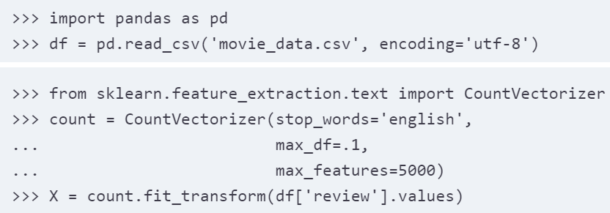
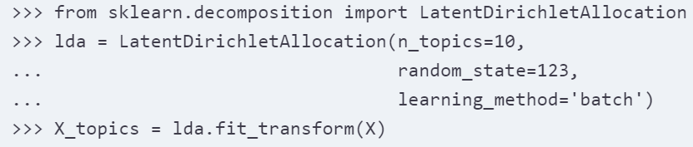
LDA Scikit-learn
We use the Latent Dirichlet Allocation class implemented in scikit-learn to decompose the movie review dataset and categorize it into different topics.
In the following example, we restrict the analysis to 10 different topics.
We are going to load the dataset into a pandas DataFrame using the local movie_data.csv file of the movie .
We set the maximum document frequency of words to be considered to 10 percent (max_df = 0.1) to exclude words that occur too frequently across documents. The rationale behind the removal of frequently occurring words is that these might be common words appearing across all documents and are less likely associated with a specific topic category of a given document.
We limited the number of words to be considered to the most frequently occurring 5,000 words (max_features = 5000), to limit the dimensionality of this dataset, so that it improves the inference performed by LDA.
Notes:
Example Text Documents:
Document 1: "Machine learning is exciting."
Document 2: "Exciting developments in artificial intelligence."
Document 3: "Artificial intelligence is transforming industries."
Document 4: "Machine learning and artificial intelligence are closely related."
Now, let's calculate the term frequencies and apply the specified parameters:
Calculate Term Frequencies:
+---------------------+---+-----+---+--------+-----+------+-----------+---------------+----------+---------+
| Term | a | and | | are | in | is | learning | artificial | exciting | machine |
+---------------------+---+-----+---+--------+-----+------+-----------+---------------+----------+---------+
| Document 1 (Count) | 0 | 0 | 1 | 0 | 0 | 1 | 1 | 0 | 1 | 1 |
| Document 2 (Count) | 1 | 1 | 1 | 0 | 1 | 0 | 0 | 1 | 1 | 0 |
| Document 3 (Count) | 1 | 0 | 1 | 1 | 1 | 1 | 0 | 1 | 0 | 0 |
| Document 4 (Count) | 1 | 1 | 1 | 1 | 0 | 0 | 1 | 1 | 0 | 1 |
+---------------------+---+-----+---+--------+-----+------+-----------+---------------+----------+---------+
Apply max_df = 0.1:
Exclude words that appear in more than 10% of the documents.
+---------------------+---+-----+---+--------+-----+------+-----------+---------------+----------+---------+
| Term | a | and | | are | in | is | learning | artificial | exciting | machine |
+---------------------+---+-----+---+--------+-----+------+-----------+---------------+----------+---------+
| Document Frequency | 3 | 2 | 4 | 2 | 2 | 2 | 2 | 3 | 2 | 2 |
| <= 10% Documents | 0 | 1 | 0 | 1 | 1 | 1 | 1 | 0 | 1 | 1 |
+---------------------+---+-----+---+--------+-----+------+-----------+---------------+----------+---------+
Words like "and," "is," and "in" that appear in more than 10% of the documents are excluded.

Slide 18

LDA Scikit-learn Coding
The code example demonstrates how to fit a LatentDirichletAllocation estimator to the bag-of-words matrix and infer 10 different topics from the documents.
By setting learning_method = 'batch', we allow the lda estimator do its estimation based on all available training data (the bag-of-words matrix) in one iteration, which is slower than the alternative 'online' learning method but can lead to more accurate results (setting learning_method = 'online' is analogous to online or mini-batch learning).
After fitting LDA, we have access to the components_ attribute of the lda instance, which stores a matrix containing the word importance (here, 5000) for each of the 10 topics in increasing order.
Notes:
he scikit-learn library's implementation of LDA uses the Expectation-Maximization (EM) algorithm to update its parameter estimates iteratively. We haven't discussed the EM algorithm in this chapter, but if you are curious to learn more, please see the excellent overview on Wikipedia (https://en.wikipedia.org/wiki/Expectation–maximization_algorithm) and the detailed tutorial on how it is used in LDA in Colorado Reed's tutorial, Latent Dirichlet Allocation: Towards a Deeper Understanding, which is freely available at http://obphio.us/pdfs/lda_tutorial.pdf.

Slide 19
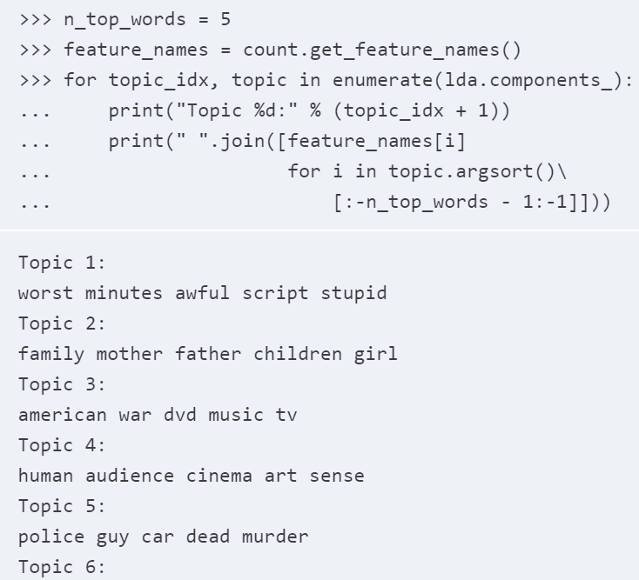
LDA Scikit-learn Coding
To analyze the results, we print five most important words for each of 10 topics. The word importance values are ranked in increasing order.
To print top five words, we need to sort the topic array in reverse order. Based on reading the five most important words for each topic, we may guess that LDA identified the following topics as
Generally bad movies (not really a topic category)
Movies about families
War movies
Art movies
Crime movies
Horror movies
Comedy movies
Movies somehow related to TV shows
Movies based on books
Action movies

Slide 20
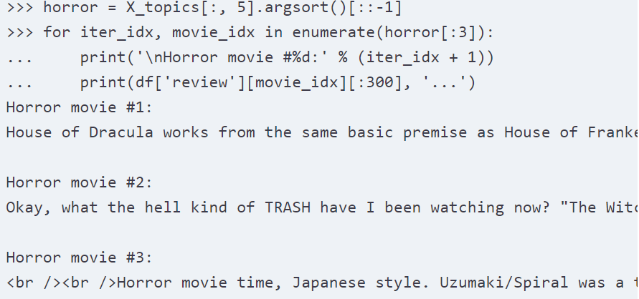
LDA Scikit-learn Coding
To confirm that the categories make sense based on the reviews, we plot three movies from the horror movie category (horror movies belong to category 6 at index position 5)
Using the code example, we printed the first 300 characters from the top three horror movies, and we can see their reviews.
We don't know which exact movie they belong to, sound like reviews of horror movies (however, one might argue that Horror movie #2 could also be a good fit for topic category 1: Generally bad movies).

Slide 21
LDA Scikit-learn Coding

Slide 22
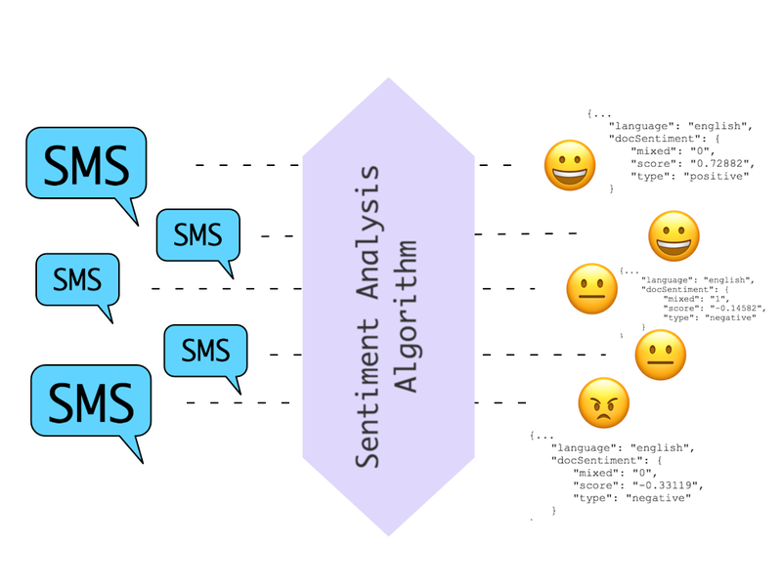
Sentiment Analysis
In this internet and social media age, people's opinions, reviews, and recommendations have become a valuable resource for political science and businesses.
We delve into a subfield of Natural Language Processing (NLP) called sentiment analysis and learn how to use machine learning algorithms to classify documents based on their polarity: the attitude of the writer.
We are going to work with a dataset of 50,000 movie reviews from the Internet Movie Database (IMDb) and build a predictor that can distinguish between positive and negative reviews.
Sentiment Analysis also called opinion mining, is a popular subdiscipline of the broader field of NLP.
It is concerned with analyzing the polarity of documents. A popular task in sentiment analysis is the classification of documents based on the expressed opinions or emotions of the authors with regard to a particular topic.
We are able to collect and analyze such data most efficiently.

Slide 23
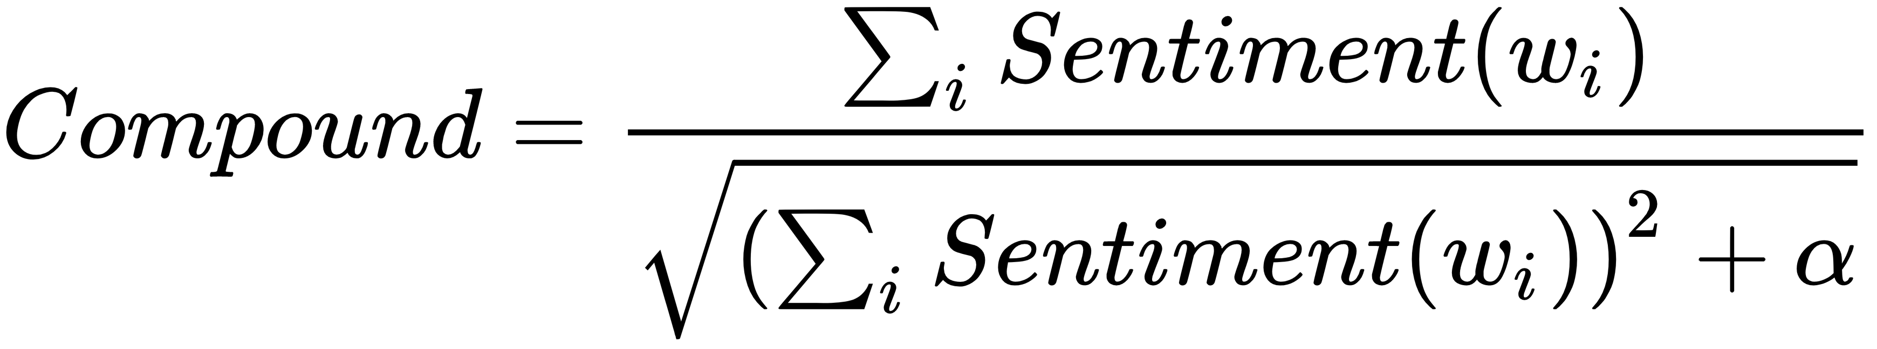
VADER sentiment analysis with NLTK
For the English language, NLTK provides an already trained model called Valence Aware Dictionary and sEntiment Reasoner (VADER) which works in a slightly different way and adopts a rule engine together with a lexicon to infer the sentiment intensity of a piece of text.
The NLTK version uses the SentimentIntensityAnalyzer class and can immediately be used to have a polarity sentiment measure made up of four components:
Positive factor
Negative factor
Neutral factor
Compound factor
The first three don't need any explanation, while the last one is a particular measure (a normalized overall score), which is computed as follows:
Here, Sentiment(w_{i}) is the score valence of the word w_{i} and α is a normalization coefficient that should approximate the maximum expected value (the default value set in NLTK is 15).
Notes:
Here, Sentiment(w_{i}) is the score valence of the word w_{i} and α is a normalization coefficient that should approximate the maximum expected value (the default value set in NLTK is 15). The usage of this class is immediate, as the following snippet can confirm:

Slide 24
Resources/ References
Python Machine Learning, Sebastian Raschka, Vahid Mirjalili, Packt Publishing, September 2017.
Practical Natural Language Processing, Sowmya Vajjala, Bodhisattwa Majumder, Anuj Gupta, Harshit Surana, June 2020, O'Reilly Media, Inc., ISBN: 9781492054054.
Introduction to Machine Learning with Python A Guide for Data Scientists, Andreas C. Müller and Sarah Guido, Copyright © 2017, O'Reilly.
Machine Learning with Python Cookbook, Chris Albon, Publisher: O'Reilly Media, Inc., Release Date: March 2018, ISBN: 9781491989388.
https://www.datacamp.com/community/tutorials/text-analytics-beginners-nltk
Copyright Notice The following material has been communicated to you by or on behalf of CCT College Dublin in accordance with the Copyright and Related Rights Act 2000 (the Act). The material may be subject to copyright under the Act and any further reproduction, communication or distribution of this material must be in accordance with the Act. Do not remove this notice

